Slide 1

Gamification in Human Resource Management
Enhancing Employee Engagement and Motivation
Presented By:
Mubarak Ismail, Jalaal Deen Umar, Salahudeen Ridwanullah Abiola
Supervised By:
Dr. Majed Hariri | Islamic University of Madinah

Slide 2

The Disengagement Crisis
Approximately 70% of employees globally experience demotivation. Traditional engagement tools are failing, particularly among the digitally-native younger workforce.
Traditional HRM
Gamified HRM
● Methods: Annual reviews & standard training
● Incentives: Purely financial rewards
● Outcome: Short-lived motivation spikes
● Audience Fit: Fails to engage Gen Z & Millennials
● Methods: Interactive learning & challenges
● Incentives: Real-time feedback & mastery
● Outcome: Sustained intrinsic motivation
● Audience Fit: Highly resonates with digital natives
VS

Slide 3
Project Aim & Objectives
Evaluating the effectiveness of gamification at the Islamic University of Madinah.
1
3
Identify Mechanics
Determine the most effective gamification elements (points, badges, leaderboards)
Compare Groups
Compare engagement levels between demographic groups (Gen Z/Millennials vs. older staff).
2
4
Analyze Impact
Measure the psychological impact on intrinsic motivation using the SDT framework.
Propose Strategies
Develop actionable implementation strategies to overcome institutional organizational barriers.
Notes:
- need to create a google form and include the gaming mechanics "PBL"

Slide 4
The PBL Triad
The structural “hooks” that drive sustained employee engagement and motivation.
Badges
Visual representations of skill attainment, certifications, and milestones. Appeals highly to Gen X.
Points
Provide instant feedback on daily tasks and quantify progress over time, driving achievement motivation.
Leaderboards
Utilize social comparison to foster healthy competition and peer visibility. Highly preferred by Gen Z.

Slide 5

Self-Determination Theory (SDT)
Autonomy
Control & Choice
Employees choose their path, increasing task ownership. Fulfilled by quests and challenges.
Competence
Mastery & Skill
Immediate proof of skill growth and mastery. Fulfilled by points and leveling systems.
Relatedness
Social Connection
Building community through recognition. Fulfilled by leaderboards and peer-to-peer kudos.

Slide 6
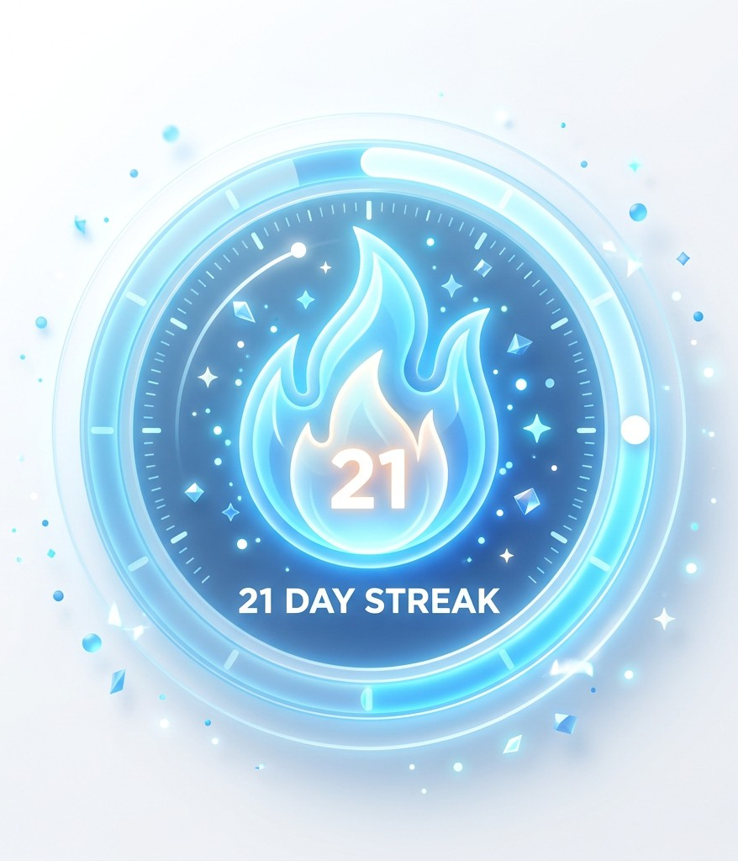
Driving Habits with streaks Mechanics
The Loop
Continuous daily logins and interactions build a "streak" multiplier. This requires minimal daily effort but maximizes system presence.
Psychological Hook
Leverages loss aversion. Employees return consistently primarily to avoid breaking the chain they've invested time in building.
System Impact
Transforms sporadic, necessity-driven HR interactions into a consistent, daily engagement ritual.

Slide 7
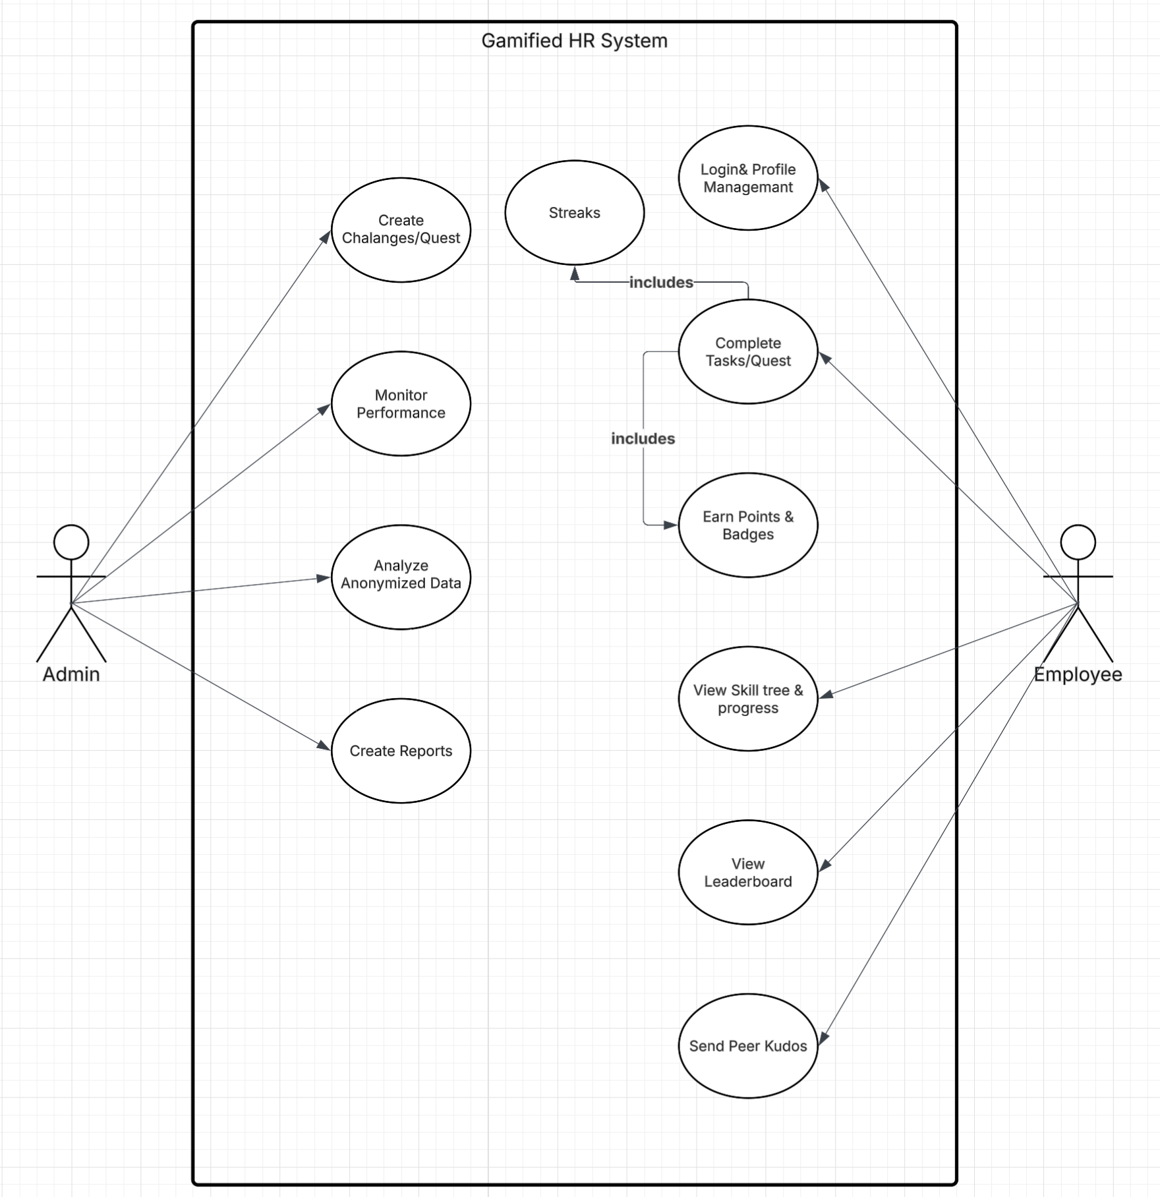
System Functional Scope
1. Gamification Engine
Automated XP allocation, badge management, dynamic leaderboards, and quest creation.
2. User & Progress Management
Comprehensive profiles featuring ranks, badge showcases, and interactive skill trees.
3. Social & Collaborative Features
Peer-to-peer recognition (Kudos) and team formations for collaborative challenges.
4. Admin & Reporting
Data anonymization, strict Role Based Access Control (RBAC) and demographic filtering.
Fig: Usecase Diagram

Slide 8
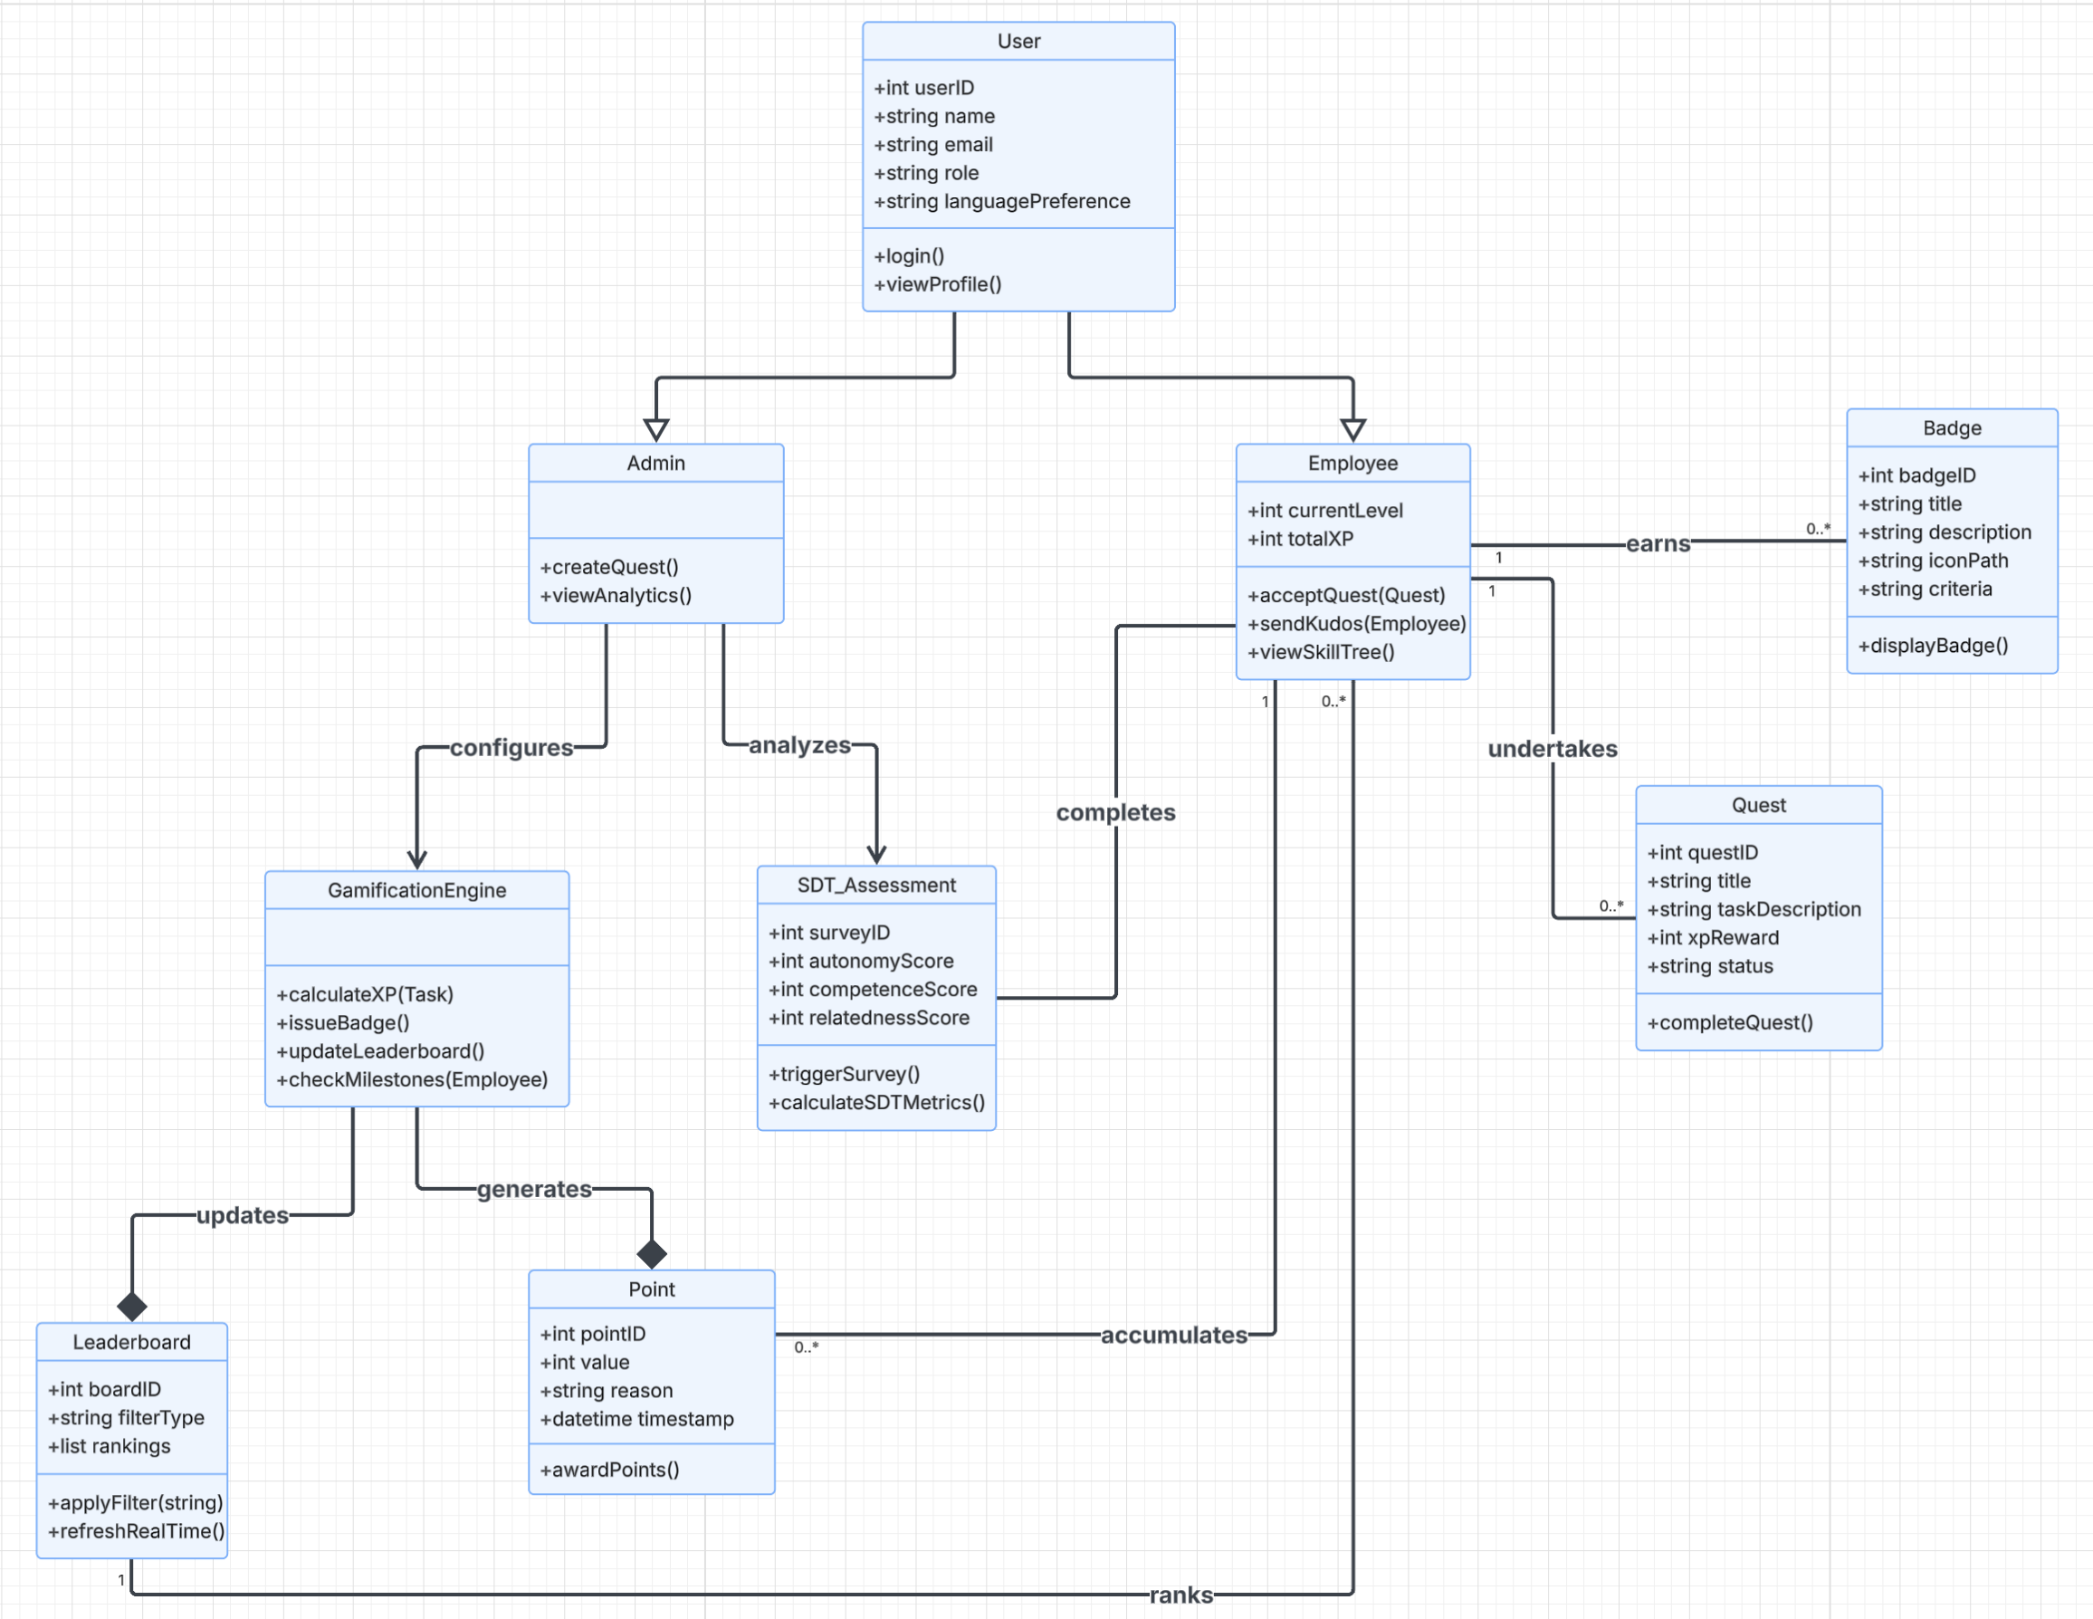
Class Diagram
Shows the structure of the system

Slide 9
Findings by Generation
Gen Z & Millennials
Gen X / Older Staff
▶ Social Competition: 40% higher preference for dynamic leaderboards.
▶ Real-Time Validation: Thrive on instant feedback and peer-to-peer Kudos.
▶ Quest Systems: Show strong correlation with Autonomy and job satisfaction.
▶ Formal Recognition: Overwhelming preference for Badges and formal certification.
▶ Competence Focus: Highly engaged by visual Skill Trees mapping career progression.
▶ Institutional Trust: Place massive value on transparent logic and immutable Audit Trails.
Notes:
- include this in the form to capture this

Slide 10
Implementation Stack
Frontend
React.js & Tailwind CSS
Responsive UI matching the IU institutional aesthetic.
i18next Localization
Seamless switching between English and Arabic interfaces.
Backend
Node.js & Express
Highly modular, incredibly fast RESTful API services.
Reward Engine
Custom middleware validating task completion before issuing XP/Badges.
Database
Redis Cache
High-performance, in-memory store for lightning-fast real-time leaderboards.
MongoDB
Secure, persistent document database for deep user profiles and audit logs.

Slide 11
Future Work
Phased Pilot
Test within a single IU technical department to gather initial metrics.
A/B Testing
Quantify exact ROI and productivity gain vs. standard conventional training.
Longitudinal Study
Multi-year tracking to measure motivation beyond the initial novelty effect.

Slide 12
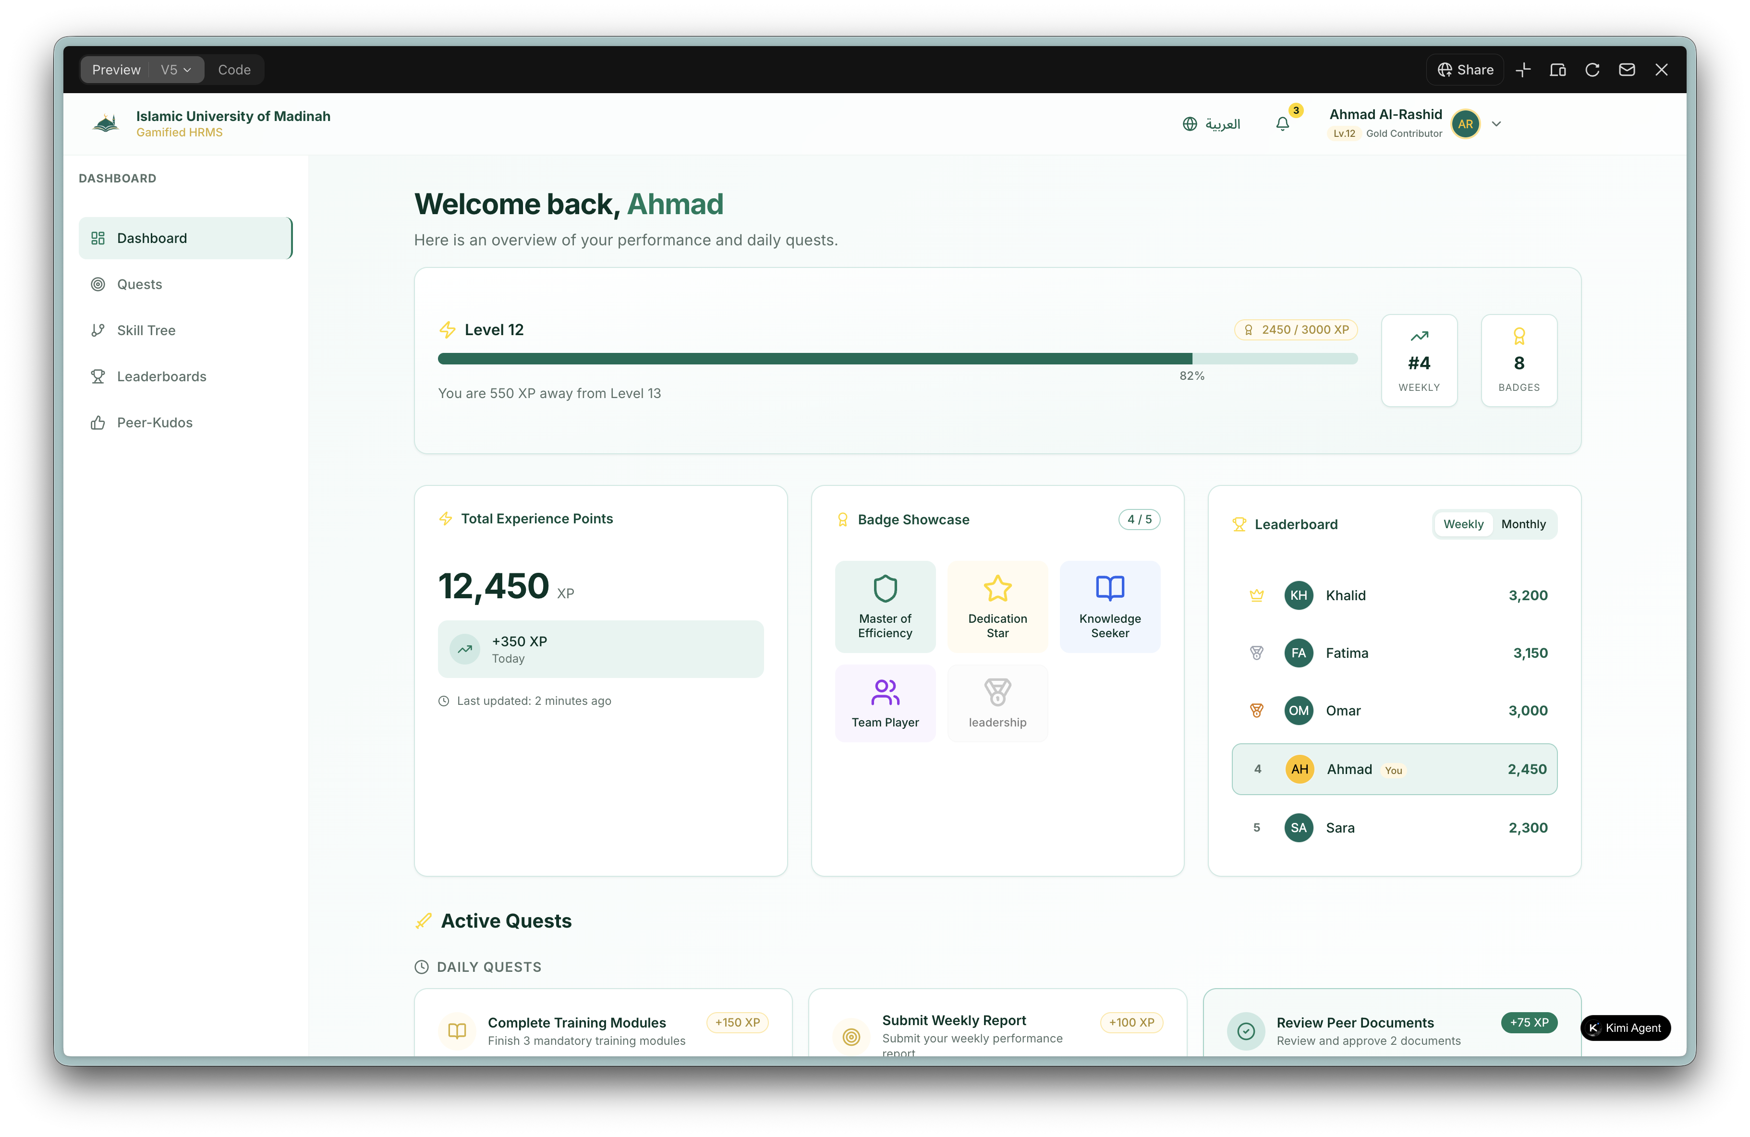
Interactive
Dashboard
Inspired by the clean, institutional design standards of iu.edu.sa, prioritizing visual clarity and focus.
Integrates real-time XP progress bars, interactive sidebars, and immediate visual reward feedback directly into the standard HR workflow.

Slide 13
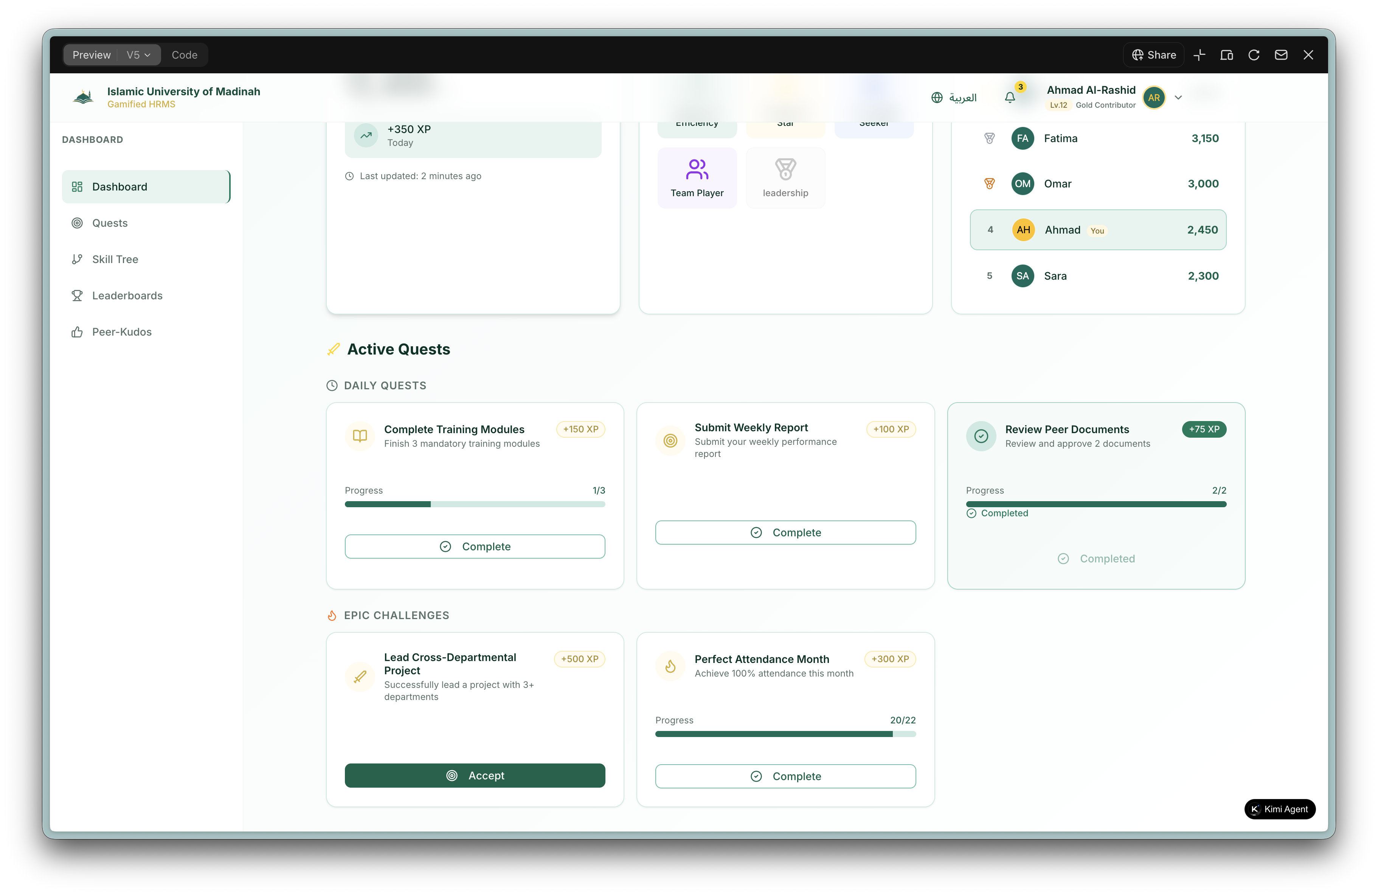
Interactive
Dashboard
Inspired by the clean, institutional design standards of iu.edu.sa, prioritizing visual clarity and focus.
Integrates real-time XP progress bars, interactive sidebars, and immediate visual reward feedback directly into the standard HR workflow.

Slide 14
Conclusion
This Project demonstrates that gamification is not merely "playing games" at work but a sophisticated technological framework for fulfilling the psychological needs of Autonomy, Competence, and Relatedness. By implementing the PBL Triad with real-time feedback, the Islamic University of Madinah can bridge the disengagement gap, particularly among its digital-native workforce.

Slide 15
Thank You
Questions & Discussion

